Slide 1
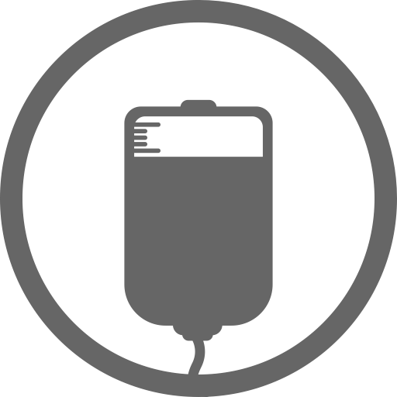
Blood Point
We offer a Mobile application on Blood donation for Android Devices. Blood donation is useful for every person and they will want to use, like this service. This our target to connect them.
Most of user using Android Device that’s why we want to use this kind of application. By this way you can reach most of people and will get better result.
We are confident to use this solution. Our team already analyzed about this project. The following benefits you will get by this project
Social Work
Branding
Goodwill
Social Work :- Nowadays its very important for a company to attend any kind of social activities. It is the best way to attend social activities.
Branding :- By this project you can Branding your company to every user.
Goodwill : - You can earn Goodwill by this project easily without extra cost.

Slide 2

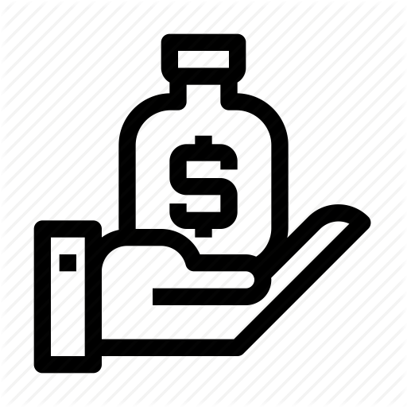
Agenda
We believe helping is the best process to live together.
Confirm their availability
Save life
Collecting Donor
Save Money
For increasing
Blood Service

Slide 3

App Features
Our app Features are below with details.
Blood Group
Reminder
Organize with all blood group
Reminder for blood donating time and can track activity.
Security
Health tips
For personal information User can trust us 100%. Because we always careful about user security
Some important daily health tips.
Notification
Donor Searching
For blood request user will get notifications on up-to-date.
User can search donor according to blood group.

Slide 4
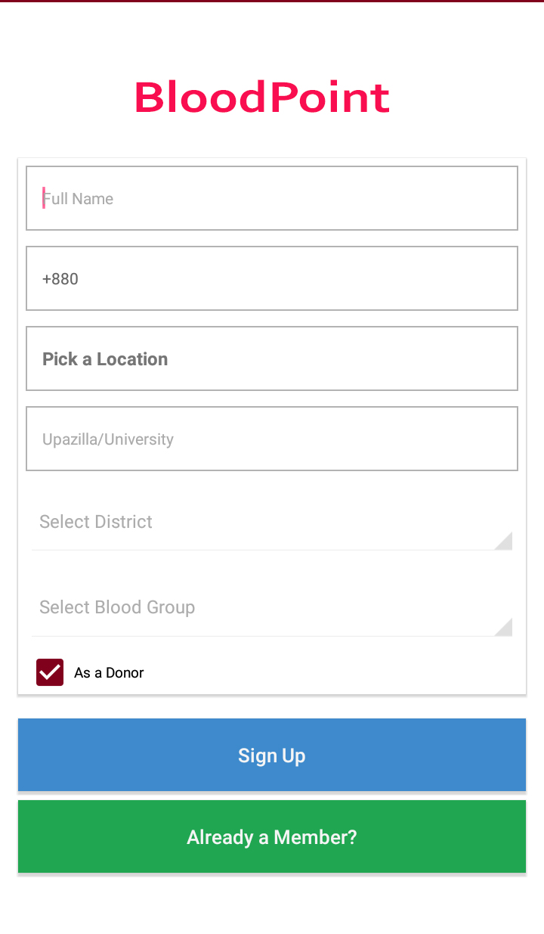
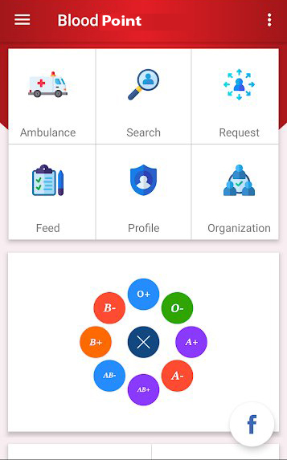
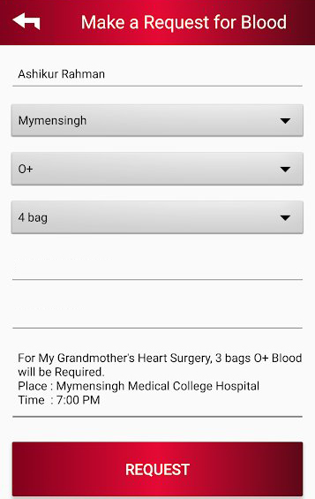
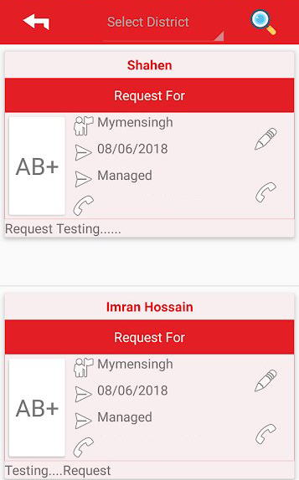
User Interface
Sign Up/ Sign In Form
User Dashboard
Request Post
Request Response

Slide 5
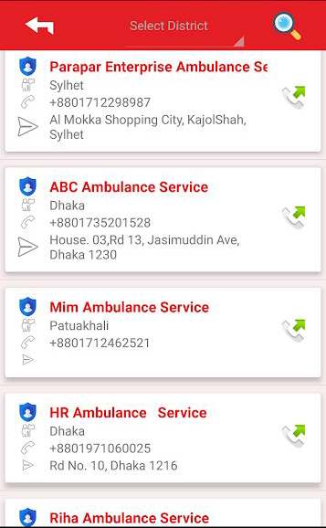
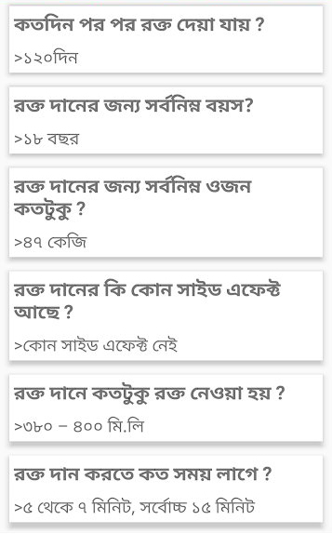
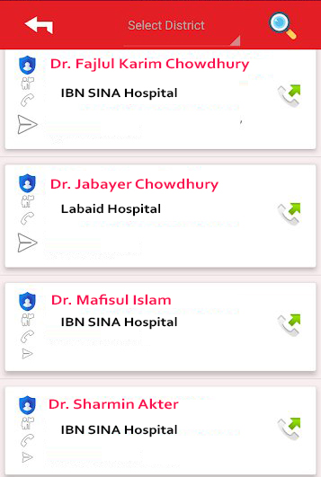
User Interface
Ambulance Service
Health tips
Doctor Search

Slide 6
Feasibility Study
Feasibility is the remarkable thing for any project. Its help to take right decision. If any project has no enough feasibility that project is not right for any organization. Overall project feasibility help any organization or individual goal. This project feasibility are given below.
1 Financial feasibility :-
We all are student in our team. We try to complete this project for our experiment. That’s why you don’t need to pay us as professional way. The potential cost are given below
2 Organizational Feasibility
As per our analysis this project have enough organization feasibility. The following feasibility you will get
You can easily branding your organization by this project.
Have no risk to loss.
Social activities.
Future reference.
3 Technical Feasibility
For this project technical feasibility is not big issue. Because we gathered enough knowledge about this project and we all are capable to complete this project.
Also this project is not big project that’s why have no complexity.
Sl No | Description | Cost
01 | Development Cost | 15,000 tk
02 | Maintenance Cost | 0.00 tk
03 | Monthly/Yearly Subscription Cost | 0.00 tk
04 | 30 Gb Cloud Storage (Monthly Subscription) | 6,000 tk
 | Total = | 21,000 tk

Slide 7
Questionnaires
* Is it User friendly ?
Yes, Of course this project will be user friendly. User can control their whole activities.
* Is there any scope to customize after launching ?
Yes, it is possible to customize after launching.
* Is it run smoothly ?
Yes, we designed it clearly and our coding will gentle that’s why it will run smoothly.
* Where data will store?
We will use a server for data store.
* How much protected a user profile ?
User profile is fully protected. We always focus in security and user can control his profile.
* Have any messaging option?
User can message to other user.
* How many time need to complete this project?
In two months we can submit this project.
* What kind of things you need to do this project?
Just your Co-Operation nothing else.

Slide 8
Use case Diagram

Slide 9
Activity Diagram

Slide 10
Class Diagram

Slide 11
Sequence Diagram

Slide 12
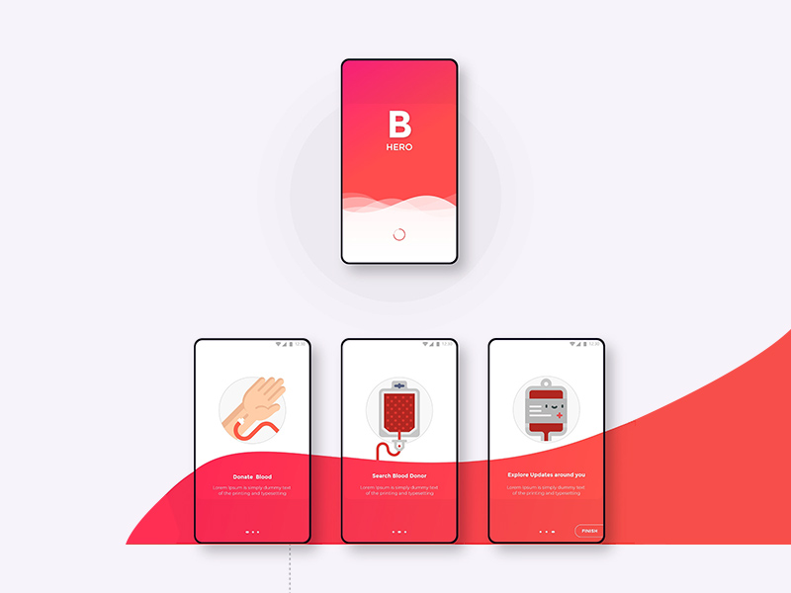


Why this project
Benefits by this app
Social work is a good thinking. For commercial we can use it for business without lose main behavior of social work. We design this app for social work as a commercial view.
Marketing
Any company can ad by this app as a social work.
Helping hand
One people can help more people by this app.
Money saving
It’s a huge idea that can save money for branding.

Slide 13
SWOT Analysis
SWOT analysis of our team.
Strength
Weakness
Opportunity
Threat
We are so confident about this project that’s why we can build it and we will.
We are not thinking about it because if we think about this it will come to us.
By this project we can make our confidence and experience more effective.
Laziness and careless is the big threat. So we all mind it.
O
W
S
T

Slide 14
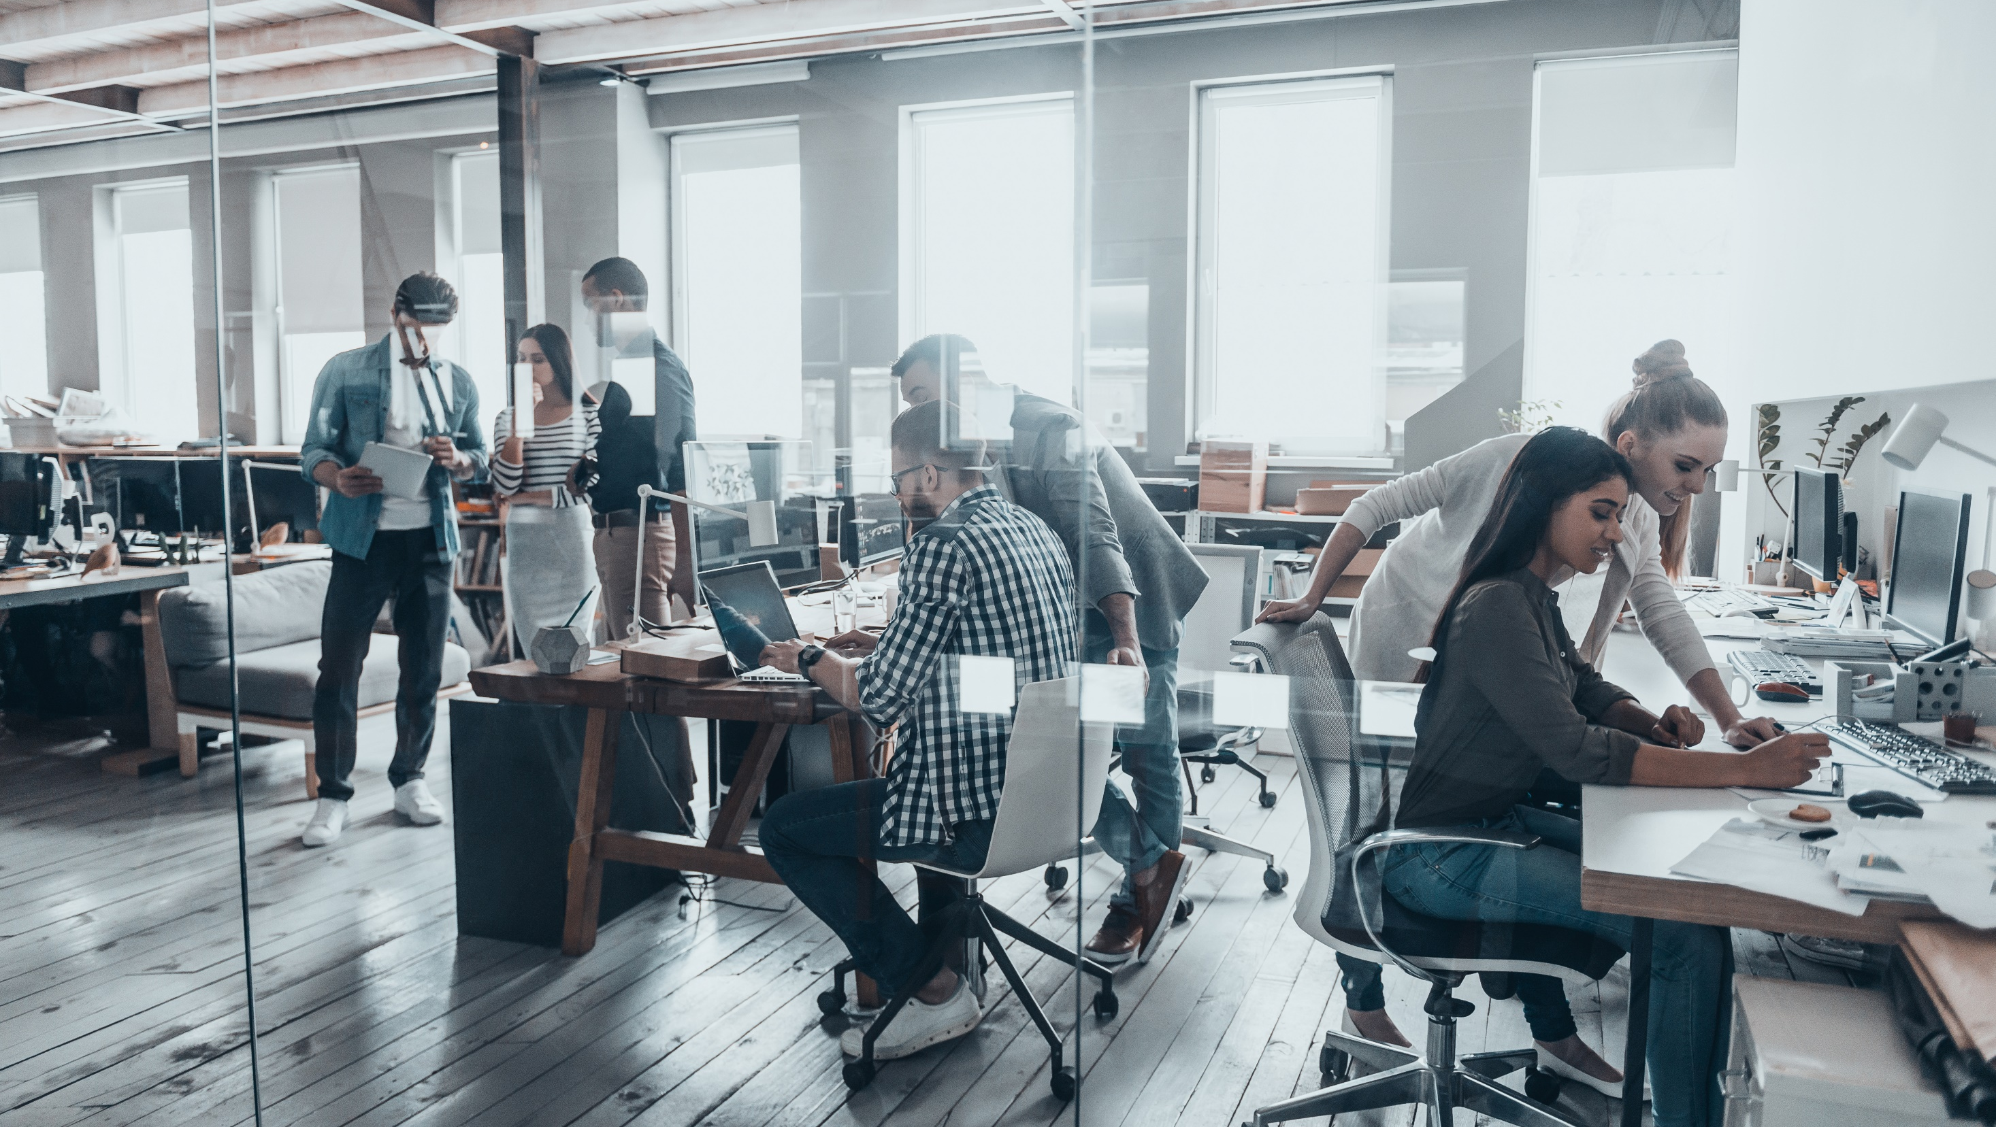
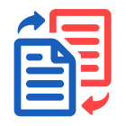



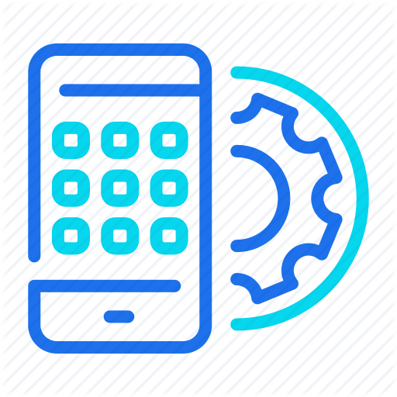
Step by Step
Our Project process
Requirement gathering.
Submit
Design
Testing
Development

Slide 15

Our Team
Fajlul Karim chowdhury
Mahadi Afzal Masom
171442505
Cse (EVE)
163432534
Cse (EVE)
Jobayer Haque
Sharmin Akter
171442591
Cse (EVE)
171442575
Cse (EVE)

Slide 16
READY TO BUILD THIS PROJECT
Conclusion
Nowadays some of similar project already done by others. But we will run this project with extra features. We can confidently say that it will be a strong startup. We spent our time on this project for clean launch. Simplicity is another feature which help to engage user.
Blood Point

